Slide 1



1
COD891: Project Presentation
Network Traffic Analysis
Instructor : Prof. Vireshwar Kumar & Prof. Tarun Mangla
27th June 2024
Sajal Verma & Manish Kumar
[2023MCS2490] [2023MCS2497]

Slide 2
OVERVIEW
The rapid evolution of digital communication networks has led to a surge in the diversity and volume of network traffic, which presents significant challenges in network management and security. i.e., security monitoring & policy enforcement.
ML approaches in network traffic classification, particularly deep learning models have shown significant results in the classification of network streams provided the H/W accelerations now available in the market, which were a matter of concern in the past
Thus, we propose Transformer based approach for Network Traffic characterization & application identification.
2

Slide 3
LITERARY REVIEW
Three main previously used methods (port-based, payload-based, time-stamp/size based statistical methods in ML) aren’t that effective, given we have encrypted data nowadays, also these require explicit feature extraction which is prone to human error & time consuming.
Although, CNNs excels at identifying spatial dependencies, i.e., they can detect patterns that represents specific types of headers, or sequences within packets.
LSTM can capture temporal dependencies in sequential data, i.e., they can identify patterns that indicate a sequence of actions or behavior across multiple packets.
Deep Packet
LSTM
3
Notes:
p

Slide 4
4
RELATED WORK
Approach | Feature Learning | Temporal Dependency Handling | Scalability | Performance on Encrypted Traffic
Traditional ML (i.e., SVM, KNN)[6] | Manual | Poor | Moderate | Poor
CNNs[12] | Automatic | Moderate | High | Good
LSTMs[14] | Automatic | Excellent | Low | Moderate
Autoencoders[13] | Unsupervised | Moderate | Moderate | Good
Hybrid (CNN-LSTM)[4] | Automatic | Excellent | Moderate | Very Good

Slide 5
PROBLEM STATEMENT
We’ve been working on the ISCX-VPN-NonVPN dataset, to classify the given network stream into various protocol classes & applications from which the packet was originated.
Following this, we’ll use the captured Network stream within our organization, to classify it appropriately & evaluate the model’s accuracy.
5

Slide 6
OBJECTIVES
To efficiently processes and classifies large volumes of network data using Transformers from raw encrypted packet data.
Extracts features crucial for classifying network traffic into predefined categories.
6

Slide 7
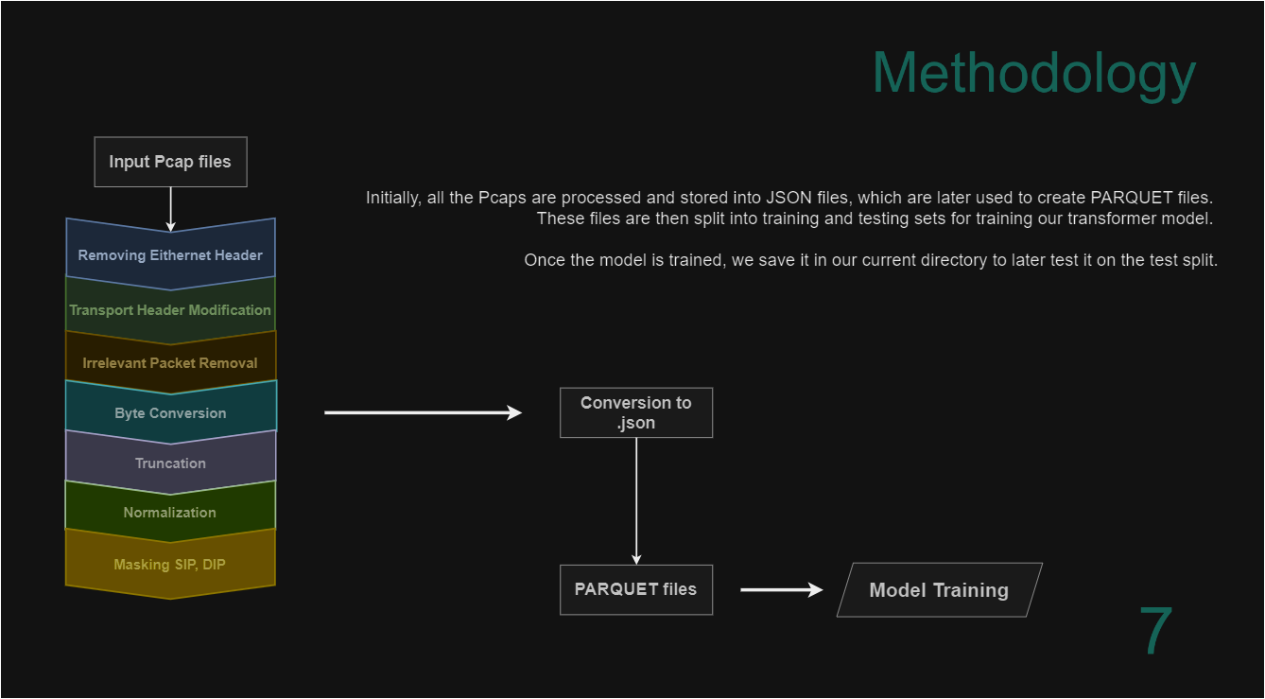

Slide 8
Deep Packet : CNN architecture
Layers:
Two consecutive convolutional layers
Followed by a pooling layer
Tensor squashed into a one-dimensional vector
Three-layered network of fully connected neurons
Hyper-parameters:
Selection Method: Grid search on a subspace of the hyper-parameters space for optimal performance
Overfitting Prevention:
Dropout Technique: Employed in the fully connected layers
Classifier: Softmax
8

Slide 9
Deep Packet : SAE architecture
Layers:
Five fully connected layers
Neurons per Layer: 400, 300, 200, 100, and 50 neurons
Overfitting Prevention:
Dropout Technique: Employed after each layer
Dropout Rate: 0.05
Mechanism: During training, some neurons are set to zero randomly at each iteration, creating a random set of active neurons
Classifier:
Softmax : Added as the last output layer
{ Application Identification: 17 neurons
Traffic Characterization: 12 neurons }
9

Slide 10
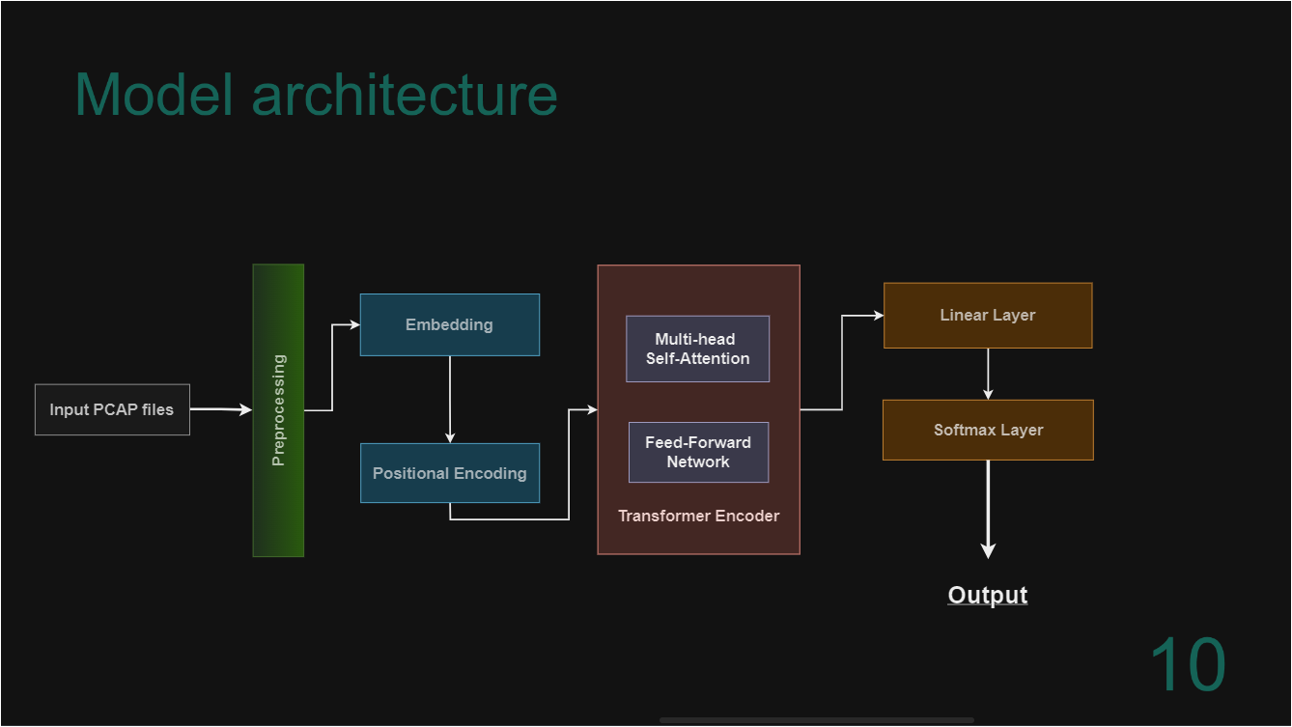

Slide 11
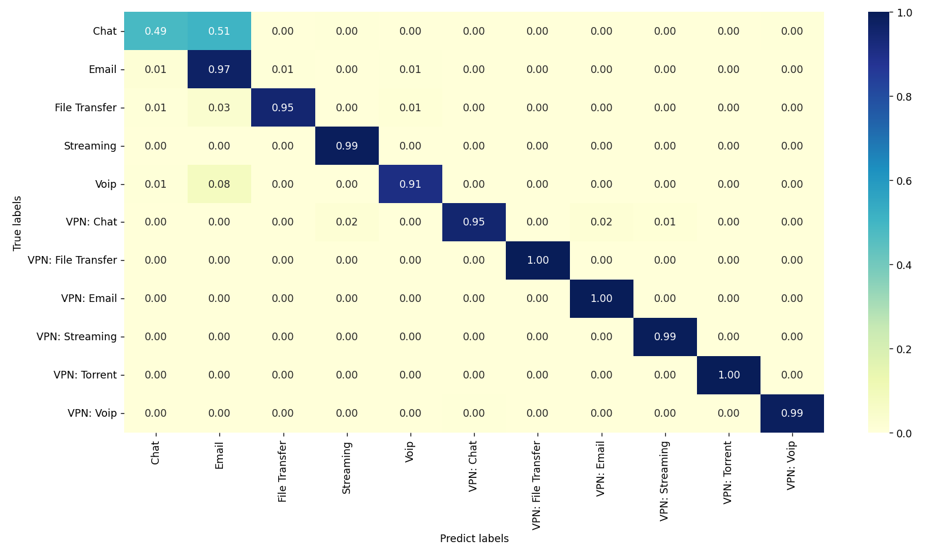
CONFUSION Matrix
11
Traffic characterization

Slide 12
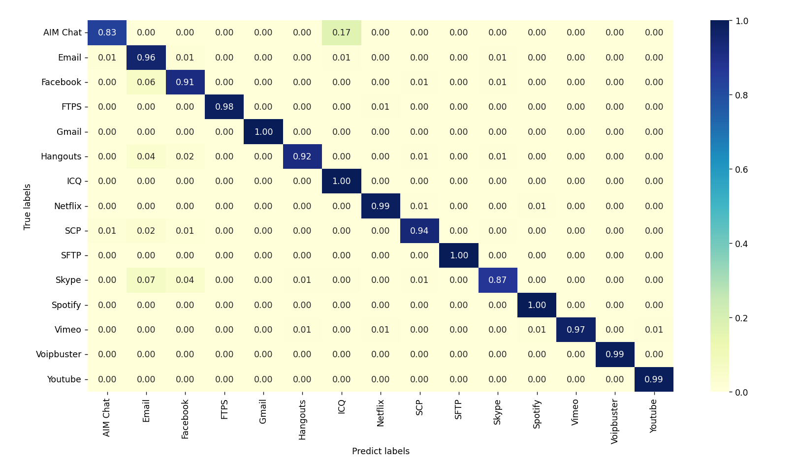
CONFUSION Matrix
12
Application Identification

Slide 13
Model Used | Recall | Precision | F1-Score
Deep Packet – CNN
Traffic Characterization | 0.94 | 0.93 | 0.93
Application Identification | 0.98 | 0.98 | 0.98
Deep Packet – SAE
Traffic Characterization | 0.92 | 0.92 | 0.92
Application Identification | 0.96 | 0.95 | 0.95
Transformer
Traffic Characterization | 0.92 | 0.98 | 0.95
Application Identification | 0.93 | 0.97 | 0.95
Result
13

Slide 14
CONCLUSION
Developed a Transformer-based model and affirmed the potential of Transformer models in network traffic and application classification tasks.
Initial Achieved Metrics: Highlight of overall accuracies:
Traffic Classification: 89.98% accuracy
Application Identification: 81.92% accuracy
Fine-tuned Metrics:
Traffic Classification: 92.10% accuracy
Application Identification : 93.25% accuracy
High precision and recall in several categories demonstrate the model's robustness.
14

Slide 15
REFERENCES
[1] Savant, V. B., & Kasar, R. D. (2021). A review on network security and cryptography. Research Journal of Engineering and Technology, 12(4), 110-114.
[2] Lotfollahi, M., Jafari Siavoshani, M., Shirali Hossein Zade, R., & Saberian, M. (2020). Deep packet: A novel approach for encrypted traffic classification using deep learning. Soft Computing, 24(3), 1999-2012.
[3] Vaswani, A., Shazeer, N., Parmar, N., Uszkoreit, J., Jones, L., Gomez, A. N., ... & Polosukhin, I. (2017). Attention is all you need. Advances in neural information processing systems, 30.
[4] Zou, Z., Ge, J., Zheng, H., Wu, Y., Han, C., & Yao, Z. (2018, June). Encrypted traffic classification with a convolutional long short-term memory neural network. IEEE 16th International Conference on Smart City; IEEE 4th International Conference on Data Science and Systems (HPCC/SmartCity/DSS) (pp. 329-334). IEEE.
[5] Alshammari R, Zincir-Heywood AN (2011) Can encrypted traffic be identified without port numbers, ip addresses and payload inspection? Comput Netw 55(6):1326–1350
[6] Bagui S, Fang X, Kalaimannan E, Bagui SC, Sheehan J (2017) Comparison of machine-learning algorithms for classification of vpn network traffic flow using time-related features. 1(2):108–126
[7] Dainotti A, Pescape A, Claffy KC (2012) Issues and future directions in traffic classification. IEEE Netw 26(1):35- 40

Slide 16
REFERENCES
[8] Finsterbusch M, Richter C, Rocha E, Muller JA, Hanssgen K (2014) A survey of payload-based traffic classification approaches. IEEE Commun Surv Tutor 16(2):1135–1156
[9] Ioffe S, Szegedy C (2015) Batch normalization: accelerating deep network training by reducing internal covariate shift. In: International conference on machine learning, pp 448–456
[10] Longadge R, Dongre S (2013) Class imbalance problem in data mining review. arXiv preprint. arXiv:1305.1707
[11] Velan P, Cermak M, ´ ˇ Celeda P, Drasar M (2015) A ˇ survey of methods ˇ for encrypted traffic classification and analysis. Int J Netw Manag 25(5):355–374
[12] Wang W, Zhu M, Wang J, Zeng X, Yang Z (2017) End-to-end encrypted traffic classification with one-dimensional convolution neural networks. In: Intelligence and security informatics (ISI), 2017 IEEE international conference on, IEEE, pp 43–48
[13] Choi, H., Kim, M., Lee, G., & Kim, W. (2019). Unsupervised learning approach for network intrusion detection system using autoencoders. The Journal of Supercomputing, 75, 5597-5621.
[14] Hwang, R. H., Peng, M. C., Nguyen, V. L., & Chang, Y. L. (2019). An LSTM-based deep learning approach for classifying malicious traffic at the packet level. Applied Sciences, 9(16), 3414. [16]Sun, P., Liu, P., Li, Q., Liu, C., Lu, X., Hao, R., & Chen, J. (2020). DL-IDS: Extracting features using CNNLSTM hybrid network for intrusion detection system. Security and communication networks, 2020, 1-11.

Slide 17

THANK YOU!
mcs232490@iitd.ac.in
mcs232497@iitd.ac.in

